Slide 1
Chapter 9: Project Human Resource Management

Slide 2
Learning Objectives
Explain the importance of good human resource management on projects, including the current state and future implications of the global IT workforce
Define project human resource management and understand its processes
Summarize key concepts for managing people by understanding the theories of Abraham Maslow, Frederick Herzberg, David McClelland, and Douglas McGregor on motivation, H. J. Thamhain and D. L. Wilemon on influencing workers, and Stephen Covey on how people and teams can become more effective

Slide 3
Learning Objectives (continued)
Discuss human resource planning and be able to create a human resource plan, project organizational chart, responsibility assignment matrix, and resource histogram
Understand important issues involved in project staff acquisition and explain the concepts of resource assignments, resource loading, and resource leveling
Assist in team development with training, team-building activities, and reward systems
Explain and apply several tools and techniques to help manage a project team and summarize general advice on managing teams
Describe how project management software can assist in project human resource management

Slide 4
The Importance of Human Resource Management
Many corporate executives have said, “People are our most important asset”
People determine the success and failure of organizations and projects

Slide 5
The Global IT Workforce
Although there have been ups and downs in the IT labour market, there will always be a need for good IT workers
The Digital Planet 2008 study estimated that the global marketplace for information and communications technology (ICT) would top $3.7 trillion in 2008 and reach almost $4 trillion by 2011 (Good news for our field of work ☺)

Slide 6
More Digital Planet Report Findings
Communications products and services:
ICT spending (57 percent) in 2007 with $1.9 trillion; consumers spent 29 percent of ICT dollars worldwide
spending by business and government accounted for 71 percent of ICT dollars
Top ten ICT spending countries are, in descending order: the U.S., Japan, China, Germany, U.K., France, Italy, Brazil, Canada, and Spain;
2008, China jumped ahead of Germany, the United Kingdom, and France
The Americas’ growth in ICT spending will be the slowest of the three broad regions at 4 percent between 2007 and 2011; the Asia-Pacific region and the Europe, Africa, and Middle East regions will grow annually at 10.5 percent and 5 percent, respectively

Slide 7
Implications for the Future of IT Human Resource Management
Proactive organizations are addressing workforce needs by:
Improving benefits
Redefining work hours and incentives
Finding future workers

Slide 8
What Went Wrong?
A 2006 report suggests that entry level workers in the U.S. are ill-prepared for the workplace
Four-year college graduates were listed as deficient in the following three skills:
Written communications - 27.8%
Writing in English - 26.2%
Leadership - 23.8%

Slide 9
What is Project Human Resource Management?
Making the most effective use of the people involved with a project
Processes include:
Developing the human resource plan:
identifying and documenting
project roles
Responsibilities
reporting relationships
Acquiring the project team
getting the needed personnel assigned to and working on the project
Developing the project team
building individual and group skills to enhance project performance
Managing the project team
tracking team member performance
motivating team members
providing timely feedback
resolving issues and conflicts
and coordinating changes to help enhance project performance

Slide 10
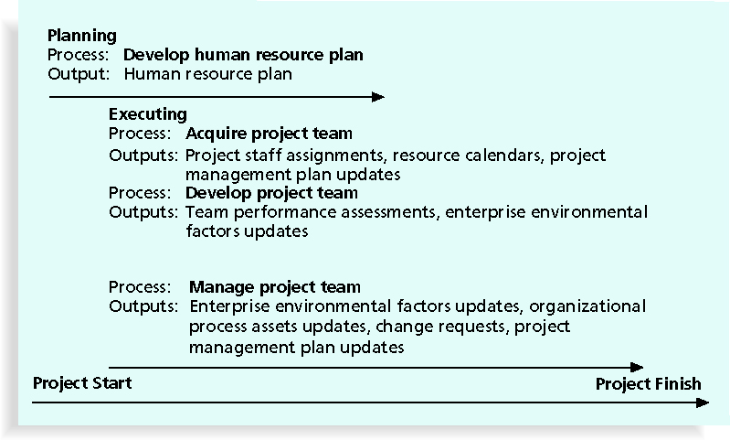
Figure 9-1. Project Human Resource Management Summary

Slide 11
Keys to Managing People
Psychologists and management theorists have devoted much research and thought to the field of managing people at work
Important areas related to project management include:
Motivation theories
Influence and power
Effectiveness

Slide 12
Intrinsic and Extrinsic Motivation
Intrinsic motivation causes people to participate in an activity for their own enjoyment
Extrinsic motivation causes people to do something for a reward or to avoid a penalty
Eg. some children take piano lessons for intrinsic motivation (they enjoy it) while others take them for extrinsic motivation (to get a reward or avoid punishment)

Slide 13
Maslow’s Hierarchy of Needs
Abraham Maslow argued that humans possess unique qualities that enable them to make independent choices, thus giving them control of their destiny
Maslow developed a hierarchy of needs which states that people’s behaviors are guided or motivated by a sequence of needs

Slide 14
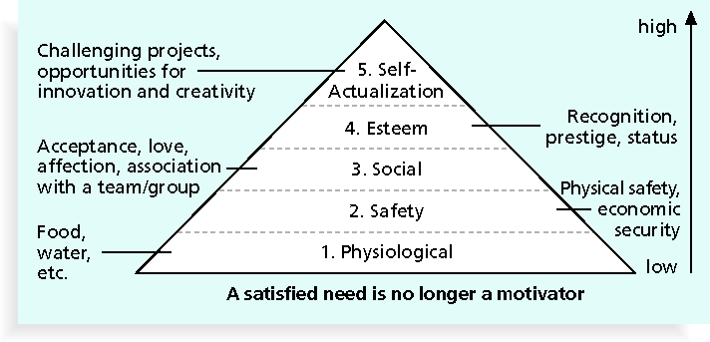
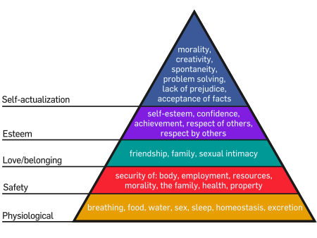
Maslow’s Hierarchy of Needs

Slide 15
Herzberg’s Motivational and Hygiene Factors
Frederick Herzberg wrote several famous books and articles about worker motivation; he distinguished between:
Motivational factors:
Achievement
Recognition
work itself
Responsibility
advancement growth, which produces job satisfaction
Hygiene factors: cause dissatisfaction if not present, but do not motivate workers to do more:
Eg. larger salaries
more supervision
attractive work environment

Slide 16
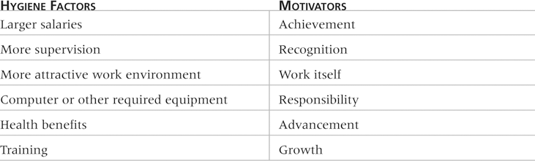
Examples of Herzberg’s Hygiene Factors and Motivators

Slide 17
Influence to succeed or fail
Projects are more likely to succeed when project managers influence with:
Expertise
Work challenge
Projects are more likely to fail when project managers rely too heavily on:
Authority
Money
Penalty

Slide 18
Power
Power is the potential ability to influence behavior to get people to do things they would not otherwise do
Types of power include:
Coercive
Legitimate
Expert
Reward

Slide 19
Covey and Improving Effectiveness
Project managers can apply Covey’s 7 habits to improve effectiveness on projects
Be proactive
Begin with the end in mind
Put first things first
Think win/win
Seek first to understand, then to be understood
Synergize
Sharpen the saw

Slide 20
Empathic Listening and Rapport
Good project managers are empathic listeners; they listen with the intent to understand
Before you can communicate with others, you have to have rapport, a relation of harmony, conformity, accord (consensus), or affinity (like Minded-ness)
Mirroring is the matching of certain behaviors of the other person, a technique to help establish rapport

Slide 21
Developing the Human Resource Plan
Involves identifying and documenting project roles, responsibilities, and reporting relationships
Contents include:
Project organizational charts
Staffing management plan
Responsibility assignment matrixes
Resource histograms

Slide 22
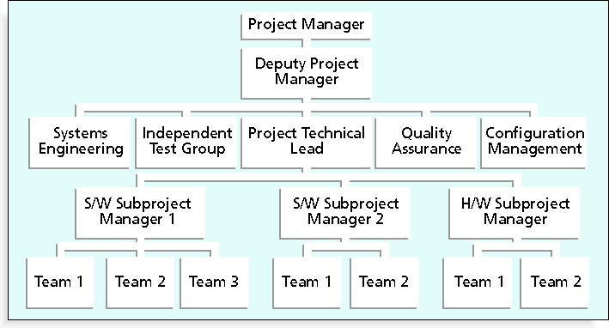
Sample Organizational Chart for a Large IT Project

Slide 23
Staffing Management Plans and Resource Histograms
A staffing management plan describes when and how people will be added to and taken off the project team
A resource histogram is a column chart that shows the number of resources assigned to a project over time

Slide 24
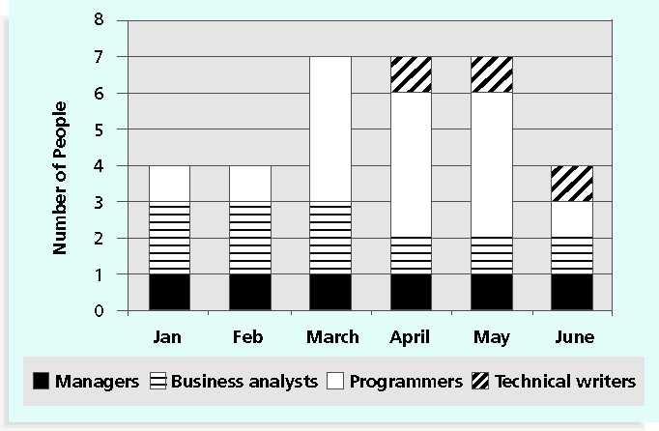
Sample Resource Histogram

Slide 25
Acquiring the Project Team
Acquiring qualified people for teams is crucial
It’s important to assign the appropriate type and number of people to work on projects at the appropriate times

Slide 26
Resource Assignment
Staffing plans and good hiring procedures are important, as are incentives for recruiting and retention
Some companies give their employees one dollar for every hour a new person they helped hire works
Some organizations allow people to work from home as an incentive
Enrollment in U.S. computer science and engineering programs has dropped almost in half since 2000
one-third of U.S. workers will be over the age of 50 by 2010
Why are the above 2 stats important?
CIO’s researchers suggest that organizations rethink hiring practices and incentives to hire and retain IT talent

Slide 27
Resource Loading
Resource loading refers to the number of individual resources an existing schedule requires during specific time periods
Helps project managers develop a general understanding of the demands a project will make on the organization’s resources and individual people’s schedules
Overallocation of resources means that more resources than are available are assigned to perform work at a given time

Slide 28
Resource Leveling
Resource leveling is a technique for resolving resource conflicts by delaying tasks
The main purpose of resource leveling is to create a smoother distribution of resource usage and to reduce overallocation

Slide 29
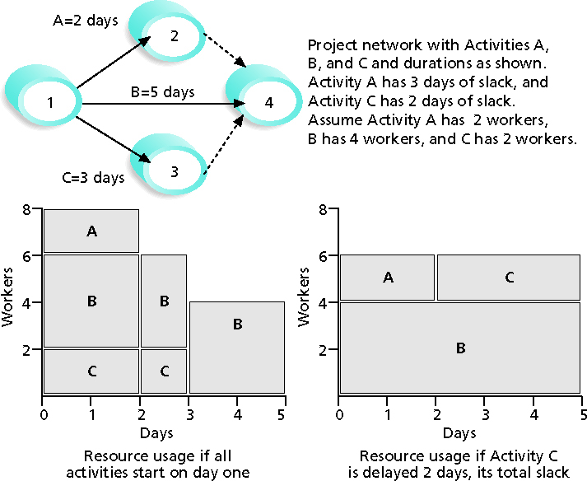
Resource Leveling Example

Slide 30
Benefits of Resource Leveling
When resources are used on a more constant basis, they require less management
It may enable project managers to use a just-in-time inventory type of policy for using subcontractors or other expensive resources
It results in fewer problems for project personnel and accounting department
It often improves morale

Slide 31
Developing the Project Team
The main goal of team development is to help people work together more effectively to improve project performance
It takes teamwork to successfully complete most projects

Slide 32
Training
Training can help people understand themselves, each other, and how to work better in teams (BAI604, BAI630 and BAI540)
Team building activities include:
Physical challenges
Psychological preference indicator tools

Slide 33
Tuckman Model of Team Development
Forming
Storming
Norming
Performing
Adjourning

Slide 34
Meyers-Briggs Type Indicator (MBTI)
MBTI is a popular tool for determining personality preferences and helping teammates understand each other.
In essence MBTI measure psychological preferences in how people perceive the world and make decisions – (Wikepedia.com)
Four dimensions include:
Extrovert/Introvert (E/I)
Sensation/Intuition (S/N)
Thinking/Feeling (T/F)
Judgment/Perception (J/P)
NTs or rationals are attracted to technology fields
IT people vary most from the general population in not being extroverted or sensing

Slide 35
Social Styles Profile
People are perceived as behaving primarily in one of four zones, based on their assertiveness and responsiveness:
Drivers
Expressives
Analytical
Amiables (socialble)
People on opposite corners (drivers and amiables, analyticals and expressives) may have difficulties getting along

Slide 36
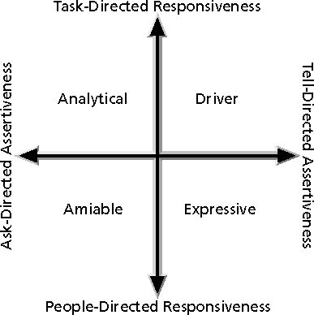
Social Styles

Slide 37
Reward and Recognition Systems
Team-based reward and recognition systems can promote teamwork
Focus on rewarding teams for achieving specific goals
Allow time for team members to mentor and help each other to meet project goals and develop human resources

Slide 38
Managing the Project Team
Project managers must lead their teams in performing various project activities
After assessing team performance and related information, the project manager must decide:
If changes should be requested to the project
If corrective or preventive actions should be recommended
If updates are needed to the project management plan or organizational process assets

Slide 39
Tools and Techniques for Managing Project Teams
Observation and conversation
Project performance appraisals
Conflict management
Issue logs
Interpersonal skills

Slide 40
General Advice on Teams
Be patient and kind with your team
Fix the problem instead of blaming people
Establish regular, effective meetings
Allow time for teams to go through the basic team-building stages
Limit the size of work teams to three to seven members

Slide 41
Five Dysfunctions of a Team
Patrick Lencioni, author of several books on teams, says that “Teamwork remains the one sustainable competitive advantage that has been largely untapped”*
The five dysfunctions of teams are:
Absence of trust
Fear of conflict
Lack of commitment
Avoidance of accountability
Inattention to results
*Lencioni, Patrick, “Overcoming the Five Dysfunctions of a Team,” Jossey-Bass: San Francisco, CA (2005), p. 3.

Slide 42
General Advice on Teams (continued)
Plan some social activities to help project team members and other stakeholders get to know each other better
Stress team identity
Nurture team members and encourage them to help each other
Take additional actions to work with virtual team members

Slide 43
Using Software to Assist in Human Resource Management
Software can help in producing RAMS and resource histograms
Project management software includes several features related to human resource management such as:
Assigning resources
Identifying potential resource shortages or underutilization
Leveling resources

Slide 44
Project Resource Management Involves Much More Than Using Software
Project managers must:
Treat people with consideration and respect
Understand what motivates them
Communicate carefully with them
Focus on your goal of enabling project team members to deliver their best work

Slide 45
Chapter Summary
Project human resource management includes the processes required to make the most effective use of the people involved with a project
Main processes include:
Develop human resource plan
Acquire project team
Develop project team
Manage project team

